Slide 1
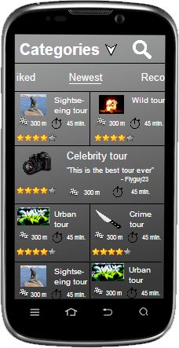
City Walk App
Problem:
Finding interesting walks in your city.
Sharing expertise or experience of a city.
Approach:
Our app will support the creation and viewing of a city walk through an intuitive interface using Google Maps.
Our app will offer the possibility to add/record a city walk.
To a specific walk it will be possible to add user created notes or POI’s found from different API’s (Flickr, Wikipedia, Foursquare).
Our focus will be on the viewing of a city walk

